Slide 1

Intrusion Detection Systems in Cybersecurity
This presentation will delve into the critical role of Intrusion Detection Systems in today's cybersecurity landscape, covering its definition, importance, types, deployment strategies, and best practices.

Slide 2

Defining Intrusion Detection Systems (IDS)
The Sentinel of Cybersecurity
Passive Guardian
An Intrusion Detection System (IDS) acts as a vigilant guardian, continuously monitoring networks and systems for suspicious activity. It identifies potential threats and raises alarms, enabling proactive security measures.
An IDS is a passive security measure, meaning it only observes and reports on threats. Unlike Intrusion Prevention Systems (IPS), it does not actively block or prevent attacks.

Slide 3

Importance of IDS in Cybersecurity
Threat Detection
Security Posture Improvement
IDS is crucial for early detection of potential threats, including malware, unauthorized access attempts, and network intrusions.
By identifying weaknesses and vulnerabilities, an IDS helps organizations enhance their security posture and implement proactive measures.
Incident Response
IDS alerts provide valuable insights into the nature and scope of incidents, enabling prompt and effective incident response.

Slide 4
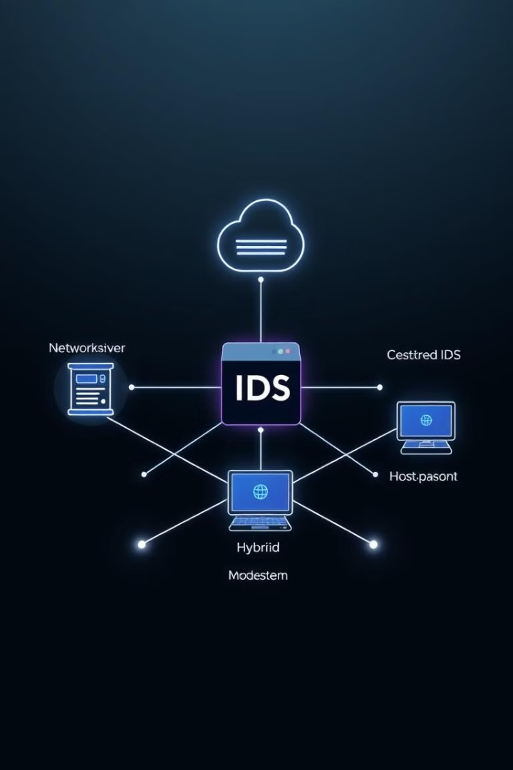
Types of Intrusion Detection Systems
Network-Based IDS
Host-Based IDS
Network-based IDS monitors network traffic for suspicious patterns and anomalies.
Host-based IDS analyzes activity within individual systems to detect malicious software or unauthorized actions.
Hybrid IDS
Hybrid IDS combines the features of both network and host-based systems for comprehensive security.

Slide 5



Network-Based IDS
Traffic Analysis
Network-based IDS examines network traffic for patterns that indicate potential attacks, such as unusual port usage or encrypted communication.
1
Signature-Based Detection
2
This method relies on predefined signatures of known threats to detect attacks.
Anomaly-Based Detection
3
This technique identifies deviations from normal network behavior, indicating potential intrusions.

Slide 6




Host-Based IDS
System Monitoring
Log Analysis
Real-time Protection
Host-based IDS continuously monitors system activity, including file access, registry changes, and process execution, to detect suspicious behavior.
It analyzes system logs for signs of intrusion attempts, malware activity, or unauthorized actions.
Host-based IDS provides immediate notification of potential threats, enabling rapid response and mitigation.

Slide 7
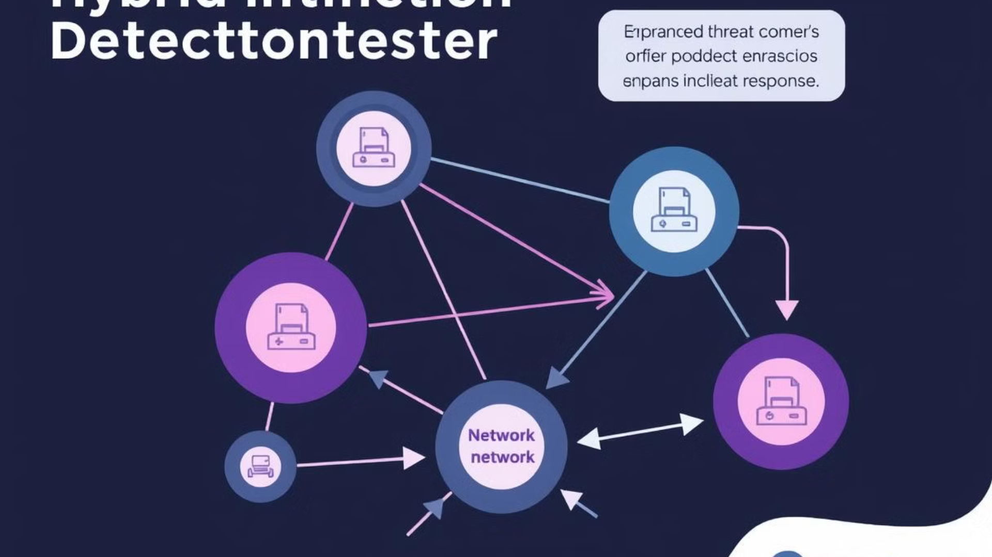
Hybrid IDS
1
Comprehensive Coverage
2
Enhanced Threat Detection
Hybrid IDS offers a comprehensive approach by monitoring both network traffic and individual systems for a unified view of security.
Combining network and host-based detection methods improves the ability to identify threats, including those that bypass traditional defenses.
3
Improved Incident Response
Integrated alerts provide a clearer picture of attacks, enabling more effective incident response and mitigation.

Slide 8
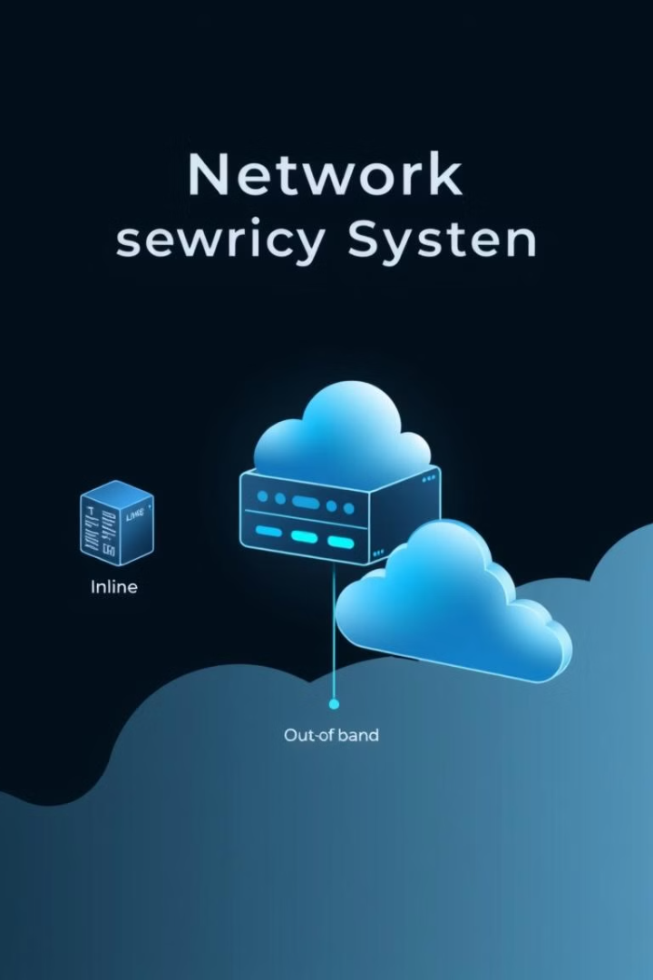
IDS Deployment Strategies
1
In-line
IDS placed directly within the network path, intercepting and analyzing all traffic.
2
Out-of-band
IDS deployed separately from the network path, monitoring a copy of the traffic.
3
Cloud-based
IDS hosted in the cloud, providing centralized management and scalable security.

Slide 9




IDS Monitoring and Alerts
Real-time Monitoring
IDS continuously monitors network and system activity, providing real-time alerts for potential threats.
Alert Configuration
Organizations configure IDS alerts based on their specific security policies, severity levels, and threat types.
Alert Analysis
Security analysts investigate alerts, determine the nature of the threat, and take appropriate action.

Slide 10

Responding to IDS Alerts
Threat Verification
Incident Response
Security Enhancement
Validate the alert to confirm if it represents a genuine threat or a false positive.
If a threat is confirmed, take appropriate actions to contain, isolate, and mitigate the attack.
Analyze the incident to identify vulnerabilities and enhance security measures to prevent similar attacks in the future.

Slide 11

THANK YOU

